Slide 1
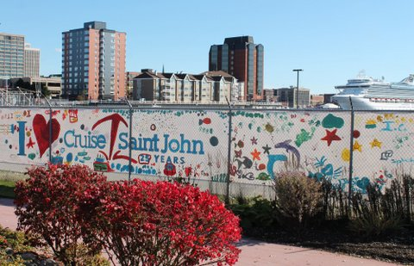
Port Saint John
Cruise 25 Campaign
Overall Campaign

